Slide 1
Project Title : Scientific Calculator
Team Members:
1. Foysal Mahmud.
2.
3.

Slide 2
Features
This Scientific Calculator allows you to perform all the basic arithmetic operations.
It also support a few basic things that are missing from the calculator are quick access to common constants like pi, 2pi, etc.
However, We can calculate binary, octal, decimal, hexadecimal, logarithmic and exponential functions etc.
It can also provide the value of sin, sinh, cos, cosh, tan, tanh.

Slide 3
Mode of the Calculator
There are two mode of this Calculator.
1. Standard Mode.
2. Scientific Mode.

Slide 4
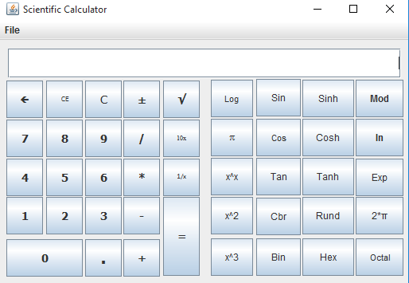
Picture of Calculator

Slide 5
Conclusion
It’s a very simple projects. But we learn many things by doing this project. We can create any button easily by using java swing and that button can perform anything what we write in actionPerformed of that button.
It’s a very short time doing our projects. But We try our best to make it batter.

